Slide 1
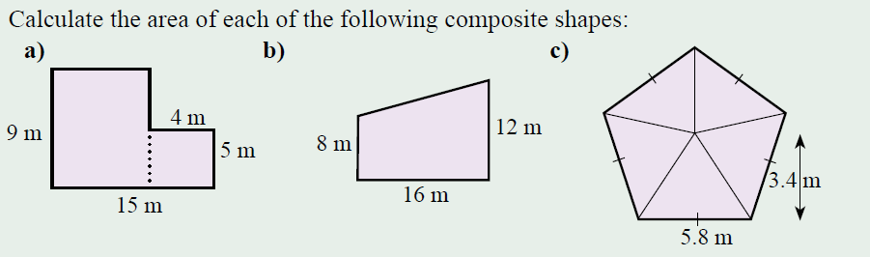
Topic: Two step Probability without replacement EQ: What Is Experimental Probability Without Replacement?
Review questions (on LHS)
Steps to be successful this lesson:
Get materials out (notebook, pen, pencil, ruler, calculator)
Rule up notebook and write Topic and EQ
Start on review questions →
Check your answers with someone sitting next to you
Is your notebook up to date? (Contents page, glossary, review notes etc.)

Slide 2
Topic: Two step Probability without replacement EQ: What Is Experimental Probability Without Replacement?
Review questions (on LHS)
Steps to be successful this lesson:
Get materials out (notebook, pen, pencil, ruler, calculator)
Rule up notebook and write Topic and EQ
Start on review questions →
Check your answers with someone sitting next to you
Is your notebook up to date? (Contents page, glossary, review notes etc.)
9×11 = 99
4× 5 = 20
99 + 20 = 119 m²
8×16 = 128
0.5 ×4 × 16 = 32
128 + 32 = 160 m²
0.5 ×5.8×3.4 = 9.86
9.86× 5 = 49.3 m²

Slide 3
Two Step Probability Without Replacement
Year 9

Slide 4
24
7
30
Topic: Two step Probability without replacement
EQ – What is experimental probability without replacement?
What is probability without replacement?
In some experiments, the sample space (list of possible outcomes) may change for the different events.
The probability for each event will be different.
Example : There are 10 marbles in a bag and you choose one and keep it (for the first selection there were 10 marbles), you choose another marble and keep it (for the second selection there were only 9 marbles to choose from).

Slide 5
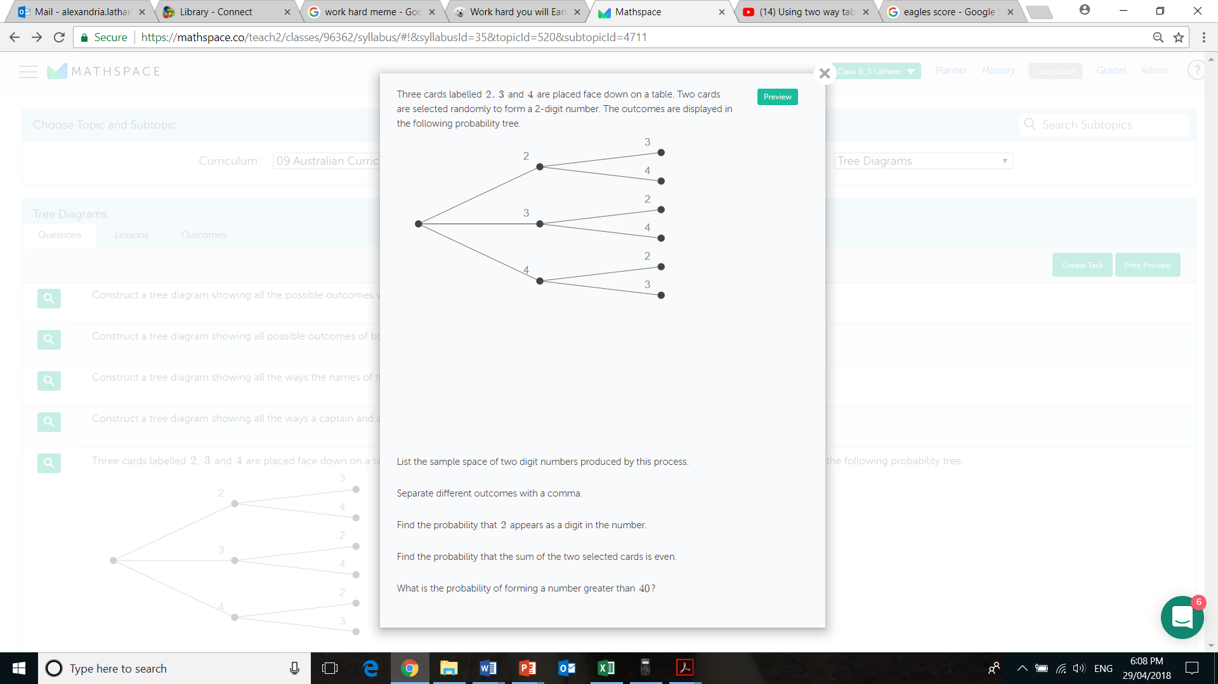
24
7
30
Topic: Two step Probability without replacement
EQ – What is experimental probability without replacement?
Example
Since the cards are selected at the same time there is no replacement.

Slide 6


Slide 7
24
7
30
Topic: Two step Probability without replacement
EQ – What is experimental probability without replacement?
Example
A bucket contains 4 blue marbles, 3 red marbles and 3 yellow marbles, two marbles are selected without replacement.
Draw the tree diagram and label the probabilities
P(BY)=
P(BB)=

Slide 9
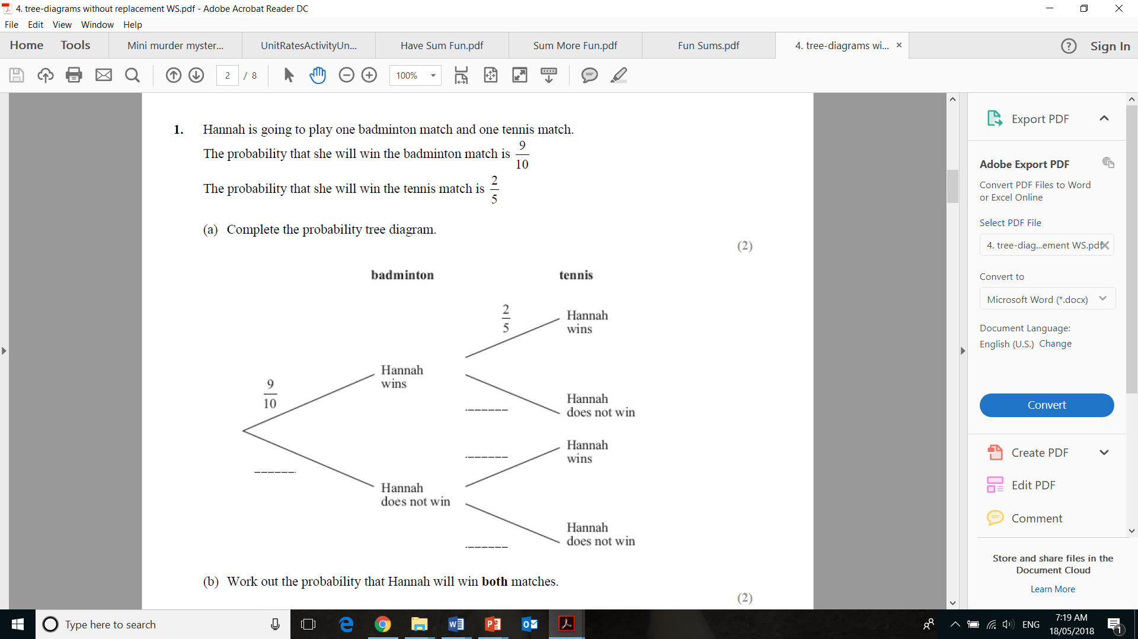

Slide 10


Slide 11
Individual work:
Tree diagrams without replacement WS

